Slide 1
Retail Sales Prediction:
Walmart Data

Slide 2

Agenda
Introduction and Business Objective
Sales Prediction & Optimization
Model build
Conclusion

Slide 3

Introduction and Business Objective
The new century is an outburst of data. These data are in continuous use of growing technology. The Retailers like Walmart, consider this data as their biggest asset to predict future sales and help in planning to generate profits and compete with other organizations.
The purpose of this project is to predict weekly sales using Walmart’s data. The historical data has been collected from Kaggle.com which contains 45 stores, the size and types of stores, and department information for each store. In addition, this dataset contains information on whether the week is a holiday week or not. The other influential information in the data set is about factors like CPI(Consumer Price Index), temperature, fuel price, promotional markdown, and unemployment rate.
Using the predictive real-time machine learning analysis the retailers can understand the optimal attainable prices for each customer and identify the right pricing to increase sales.

Slide 4




Sales Prediction - Retailers
DATA SNAPSHOT
MODEL USED
features.csv
Store - the store number
Date - the week
Temperature - average temperature in the region
Fuel Price – the cost of fuel in the region
MarkDown1-5 - anonymized data related to promotional markdowns
CPI - Consumer price index
Unemployment - the unemployment rate
IsHoliday - whether the week is a special holiday week
stores.csv
This file contains anonymized information about the 45 stores, indicating the type and size of the store.
Linier Model:
LinearRegression
Ridge
Lasso
ElasticNet
SGDRegressor
Ensemble :
RandomForest
Gradient Boost
Ada Boost
XGBoost
LGBM

Slide 5
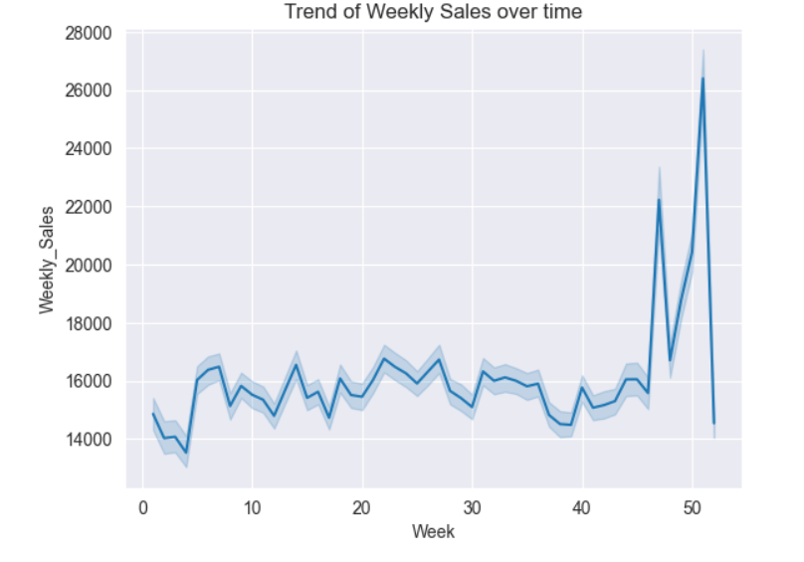
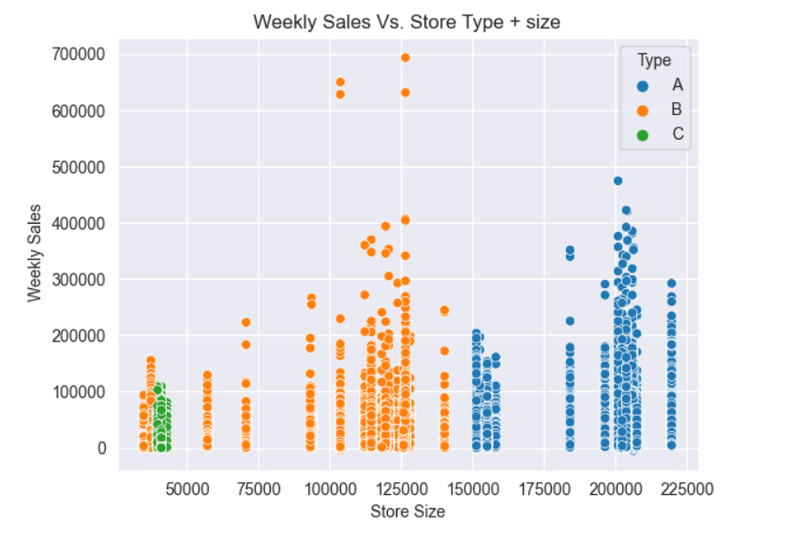
PERFORMANCE OF THE MODEL
OBSERVATIONS
A huge hike between ThanksGiving and Christmas.
After hyperparameter tuning, the model that works best with this data is Random Forest.
A is the bigger one store so sales is high as usual.
The GridSearchCV to obtain the best fit random forest model.

Slide 6
Conclusion
In this machine learning project, we have used Walmart stores’ historical data to predict weekly sales based on data given from the last three years. As we want to predict a continuous variable, this project is an example of a regression problem.
The steps are as follows:
Download the dataset from the source
Read the .csv file after converting from .zip
Feature Engineering performed – new date and time, markdown, and holiday features were applied to the dataset.
Exploratory Data Analysis performed by checking the weekly sales and trends in weekly sales.
Then the data was prepared for the model training with train, test, and validation splitting
Identify the numeric and categorical columns.
Scaling, imputation, and encoding are then done on the same data.
Model trained using linear model techniques but it was performed poorly.
Ensemble learning models are used like Random Forest, XGBoost, and LightGBM
To get the best fit model Hyperparameter tuning was used. Insight shows that the best performance was of the Randomforest model.

Slide 7


Thank You
dSights is a data tech specialist with a vision to create value through:
Outcome-Oriented AI
Fueled by
Innovative Experimentation
Github : https://github.com/ds-stratgic-work/Sales-Prediction.git

